Slide 1





CREATION CURATION
Meal Prepping for College Students Made Easy
Section A03: Fai Li, Manuel Lopez, Joan Therese Lota, Byron Torres, Annie Wu

Slide 2
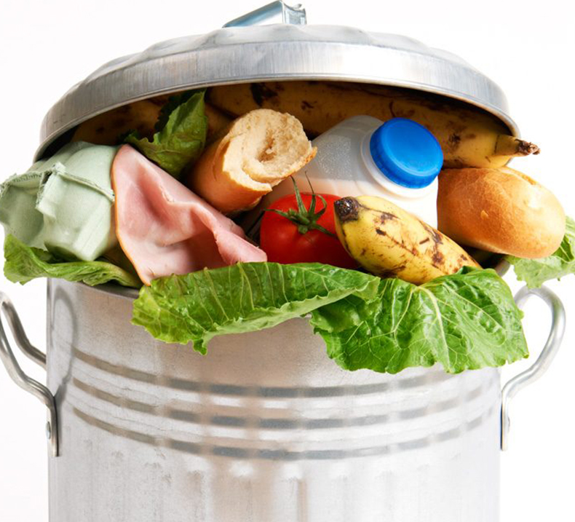


Problems of College Students
Lack of Time
Budgeting and Eating Out
Food Waste
Not Knowing:
  How to Buy Groceries
  How to Cook for Oneself
  Or What to Eat

Slide 3
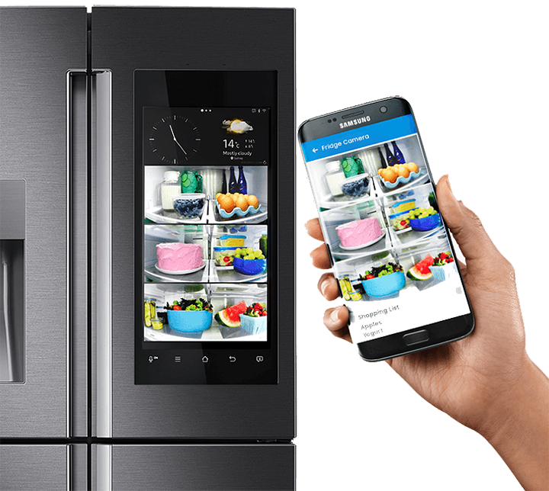
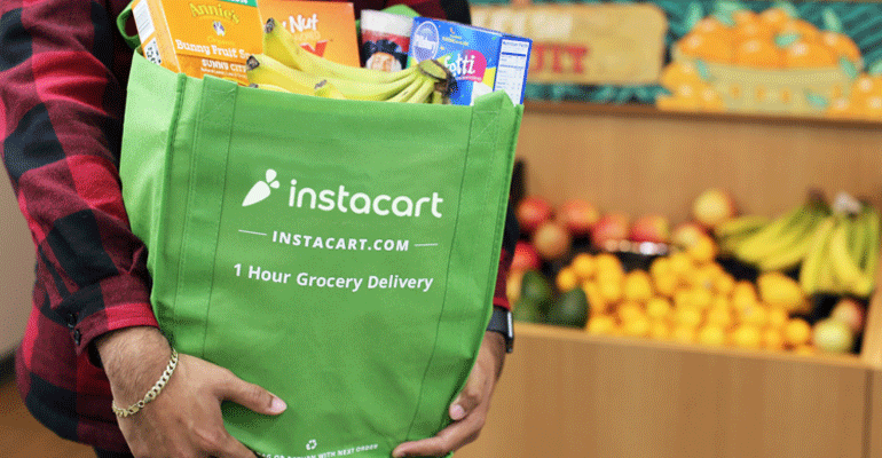
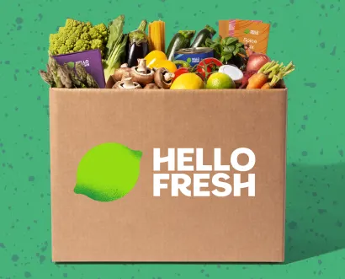
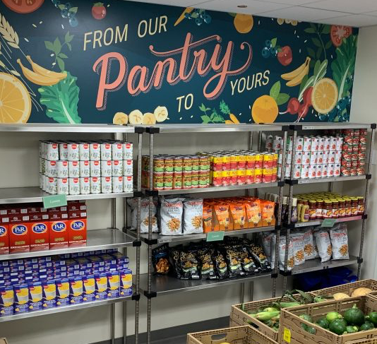
Available Solutions
Smart Fridges
Grocery Shopping Apps
Meal Delivery Kits
EBT
On Campus Food Pantries
On Campus Meal Plans

Slide 4

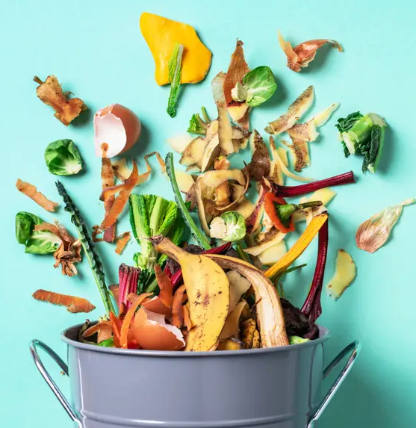
Current State of Problem
40% of college students skip meals
$341 a month spent eating off-campus, whereas only $206 a month spent on groceries
Average restaurant meal costs $12.75 but only costs $4.25 to make (300% markup)
Food waste on average:
  142 pounds/student/year on campus
  38 pounds/student/year off campus

Slide 5

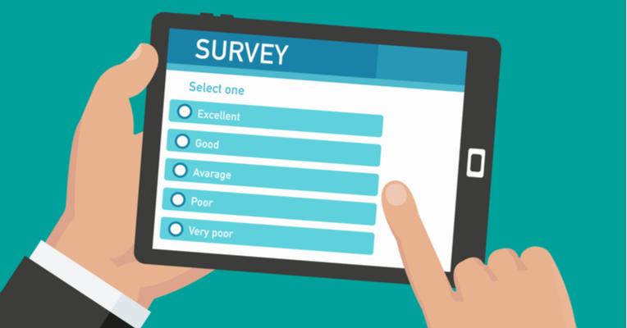
Why Creation Curation is Best!
Affordable
Easily accessible
Promotes planning, cooking, and budgeting
Takes into account one’s availability
Based on one’s preferences
Resourceful

Slide 6

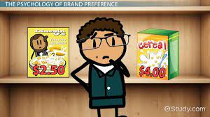
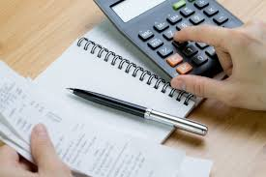

Proposed Solution:
1: Subscription-based service
2: Personalized List of Recipes Generated Each Week taking into account:
Preference
Budget
Desired Serving Size

Slide 7
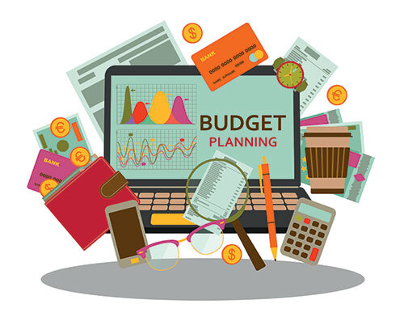
Novelty
Why are we better than other recipe apps?
Our APP Considers The Cost Range Of Recipes and Personalization
Advantages?

Slide 8
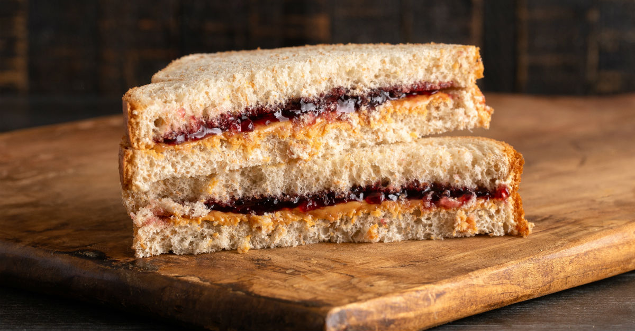
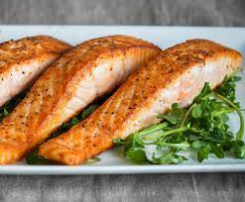
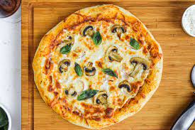
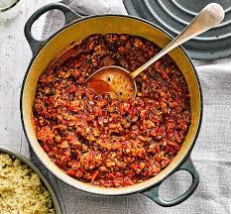
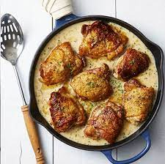
Mobile Project
Recipe Recommendations Based on Weekly Surveys & Recent Searches
Filter Search Feature
Recipe Variations
KeyWord Search
Search:
INGREDIENTS
Bread ($2.99 - $5.99)
Raspberry Jam ($2.99-4.99)
Peanut Butter ($3.99-$12.99)
Total: ($9.97 - $29.97)
PB&J (Raspberry Jam)
TAKE SURVEY HERE
Price Range:
$Min - $Max
Notes:
Grocery list

Slide 9
Mobile Project
Recipe Recommendations Based on Weekly Surveys & Recent Searches
Filter Search Feature
Recipe Variations
KeyWord Search
Search:
INGREDIENTS
Bread ($2.99 - $5.99)
Raspberry Jam ($2.99-4.99)
Peanut Butter ($3.99-$12.99)
Total: ($9.97 - $29.97)
PB&J (Raspberry Jam)
TAKE SURVEY HERE
Price Range:
$Min - $Max

Slide 10

Data Model / Designing Methods
1. Location - App Developers + Consumer
2. Price Ranges - App Developers + Store Websites + location
3. Personalization - App Developers + Consumers
4. Recipes - Recipe Websites + App Developers
5. Run Tests - App Developers

Slide 11
Survey Writers
Survey
App Designers
App Infrastructure
CREATION CURATION
Student Purchasing Subscription and Filling Out Survey
AI Processing Results
Programmers
Data Scientists
Students Receiving Weekly Recipe Plans
Recipes from Public Databases
AI Prototype
Trained AI
Prices of Grocery Items

Slide 12

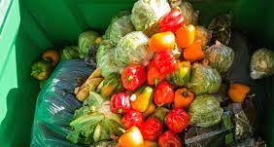

Potential Problems:
1: Food Safety
2: Spoilage
3: Copyright

Slide 13


Suggest solutions:
1. Caution Reminder
2: Customized Size of Ingredients to Prevent Food Spoilage + Ingredients Are KeyWords In Our Search Engine
3. We Will Use Copyright Free Recipes
Example: https://cookeatshare.com/popular/copyright-free-recipes

Slide 14
General Timeline
Planning Stage:
Establishing expectations on budget, a monthly timeline, and milestones
Design and Pre-development:
Work along app developers to design application
Pilot Testing before launching:
Launch beta version of app
Review student input for beta version
App Launch & Additional Development:
Launch app in the Apple Store and Google Play Store
Start advertising app (e.g. student ambassadors via social media, commercials, ads, etc)
2022
JAN
FEB
MAR
JUL
DEC
2023
JAN
FEB
JULY
Business Analysis:
Meet with business analysis specialists and developers to create solutions from our idea
Contact bank for loan offers to establish baseline funding.
Present our project to private investors for additional funding offering future stockholder equity.
Publicize internship opportunities for student ambassadors (for student input/future promotion opportunities)
Application Development
Finalizing App:
Fix any problems in the app identified during testing
App Updates:
Any reviews done by consumers will be taken into consideration to improve the experience using the app

Slide 15
General Timeline
Planning Stage:
Establishing expectations on budget, a monthly timeline, and milestones
Design and Pre-development:
Work along app developers to design application
Pilot Testing before launching:
Launch beta version of app
Review student input for beta version
App Launch & Additional Development:
Launch app in the Apple Store and Google Play Store
Start advertising app (e.g. student ambassadors via social media, commercials, ads, etc)
2022
JAN
FEB
MAR
JUL
DEC
2023
JAN
FEB
JULY
Business Analysis:
Meet with business analysis specialists and developers to create solutions from our idea
Contact bank for loan offers to establish baseline funding.
Present our project to private investors for additional funding offering future stockholder equity.
Publicize internship opportunities for student ambassadors (for student input/future promotion opportunities)
Application Development
Finalizing App:
Fix any problems in the app identified during testing
App Updates:
Any reviews done by consumers will be taken into consideration to improve the experience using the app

Slide 16
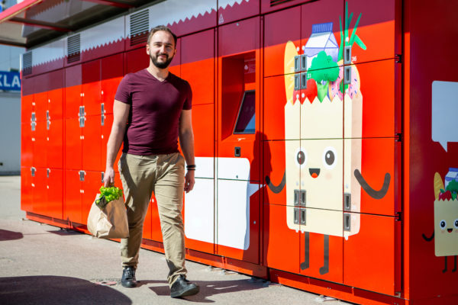
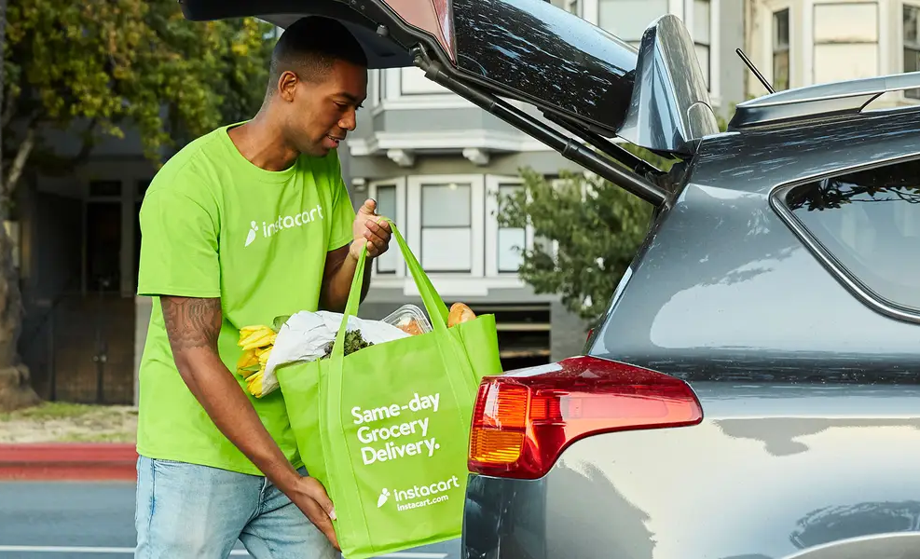
Scaling Up
Cooperate with Universities to Establish Food Pick-Up Locations on Campus
Form partnerships with universities to establish designated food pickup spots on campus in which grocery services can then deliver mass orders and students enjoy easy accessibility with picking up their groceries.
1
Expand to Offer Grocery Delivery Services
Reach out to established local grocery delivery services (Instacart, Amazon Fresh, etc.) to establish partnerships to offer user to order groceries in-app
2
Establish Loyal Consumer Base (1 year)
Analyze retention rate of app users to see which packages (weekly/monthly/premium) are most attracted to and continue targeting marketing/advertising to add to the loyal consumer base
3
**In the whole process, we will be adding more features/increasing the user friendliness of the app

Slide 17

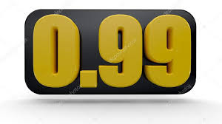
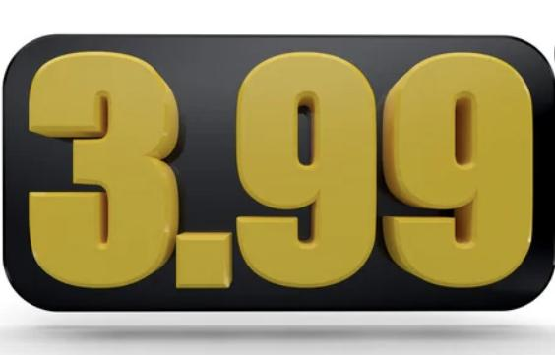
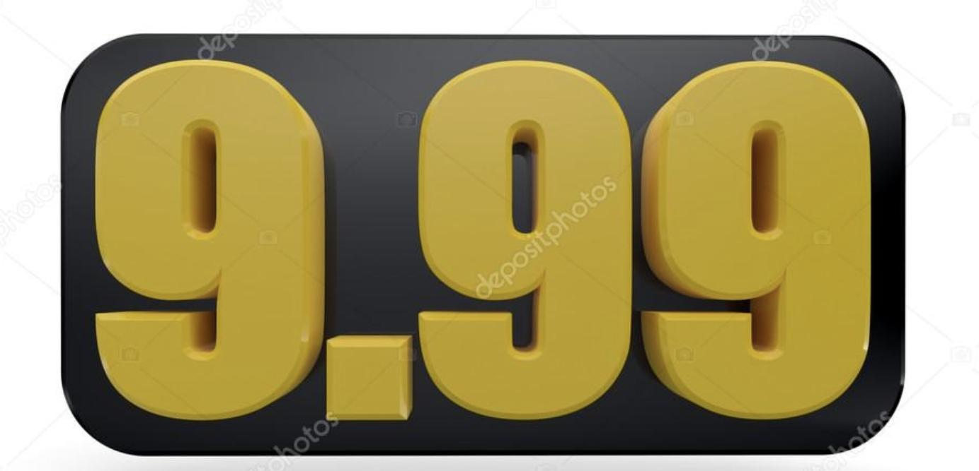
RETAIL PRICING
(Weekly) Standard with Ads: $0.99
(Monthly) Standard with Ads: $3.99
Premium (no ads): $9.99

Slide 18
Estimated Budget (First Year- Pre App Launch)
 | Debits | Credits | NET GAIN
Initial Round of Funding (loans, investors, etc.) | $200,000 | ----- | +200,000
Producing Costs (app development - programmers/designers) | ----- | app developers → 60k data scientists → 15k AI development → 50k $125,000 | -125,000
Marketing Costs (social media advertising through influencers-- Youtube, Tik Tok, Instagram, FB) | ----- |  | -50,000
OVERALL NET GAIN/LOSS | ----- | ----- | +25,000
Notes:
Advertising + revenue + column descriptions

Slide 19
$200,000
50,000 subscriptions*
PROFIT: $199,500
Investor Pitch
Offering 20% of each subscription till the investor(s) are paid back their initial investment full → then transition to 10% equity stake in the company
That’s a lot of money to ask for
But with a lot of users
50,000 subscriptions x $2.99 = $199,500
Total success!
*calculated using cheapest option for a more conservative estimate → monthly with ads ($3.99)

Slide 20
Estimated Budget (First Year- Post App Launch)
Revenue (assuming 50,000 subscriptions) | 50,000 subscriptions x $3.99 = $199,500 | ----- | +199,500
Advertising Revenue (assuming 90% of standard subscription) | 50,000 subscriptions x 0.90 = 45,000 subscriptions x $3.50 per CPM = $157,500 | ----- | +157,500
Distribution Costs (App Store costs/30% Commission) | ----- | 50,000 subscriptions x $3.99 = $199,500 $199,500 x .30 = $59,850 (apple store + play store) $99 annual fee for Apple Developer Program $25 one time fee to create developer account for Google Play Store | -60,000
Pay Back Investors (20% of each subscription until they are paid back in full → 10% per subscription) |  | 50,000 subscriptions x $3.99 = 199,500 $199,500 x .20 = $39,900 | -39,900
OVERALL NET GAIN/LOSS | ----- | ----- | +282,100

Slide 21
Estimated Budget (Second year)
 | Debits | Credits | NET GAIN
Rollover Revenue | $282,100 | ----- | +282,100
Producing Costs (app maintenance, additional features, delivery expansion) | ----- | app maintenance → 15k delivery expansion → 35k Additional app features → 25k | -75,000
Marketing Costs (social media advertising through influencers-- Youtube, Tik Tok, Instagram, FB) | ----- |  | - 100,000
Selling Price (assuming 100,000 subscriptions) | 100,000 subscriptions x $3.99 = $399,000 | ----- | +399,000
Distribution Costs (App Store costs + Commission -- usually 15% after first 12 months) | ----- | $399,000 x 0.15 = $59,850 | -59,850
Pay Back Investors (20% of each subscription until they are paid back in full → 10% equity in the company) | ----- | $399,000 x 0.20 = 79,800 | -79,800
OVERALL NET GAIN/LOSS |  |  | + 366,450

Slide 22


Thanks!
Any questions?

Slide 23
References :
CDFA - Inspection Services - Food Recovery. https://www.cdfa.ca.gov/is/foodrecovery/#:~:text=Food%20Waste%20in%20California,tons%20of%20food%20waste%20annually
Sogari G, Velez-Argumedo C, Gómez M, Mora C (2018) College Students and Eating Habits: A Study Using An Ecological Model for Healthy Behavior. Nutrients 10:1823. https://doi.org/10.3390/nu10121823
Average Cost of Food per Month for a College Student | 2022 Analysis. In: Education Data Initiative. https://educationdata.org/average-monthly-food-spend-college-student.
Dining Costs Eating up College Students’ Budget. In: Debt.org. https://www.debt.org/students/dining-costs-eating-up-colleg-students-budget/. Accessed 23 Feb 2022b
#RealCollege. Real Hunger. | California Community Colleges Chancellor’s Office. https://www.cccco.edu/About-Us/News-and-Media/California-Community-Colleges-Outlook-Newsletter/College-News.
Food Waste Estimation Guide. In: RecyclingWorks Massachusetts. https://recyclingworksma.com/food-waste-estimation-guide/.
“How Much Does It Cost to Make an App for Your Business in 2022.” Cleveroad Inc. - Web and App Development Company, https://www.cleveroad.com/blog/how-much-does-it-cost-to-create-an-app.
What’s The Timeline For Building A Mobile App?” SOLTECH, 28 Dec. 2019, https://soltech.net/whats-timeline-building-mobile-app/.
Pay-Per-Click Advertising: What Is PPC Advertising? In: WordStream. https://www.wordstream.com/pay-per-click-advertising. Accessed 23 Feb 2022
Cox LK How to Win a Deal on Shark Tank: The Anatomy of a Perfect Business Pitch [Infographic]. https://blog.hubspot.com/sales/anatomy-of-a-perfect-business-pitch.

